Slide 1


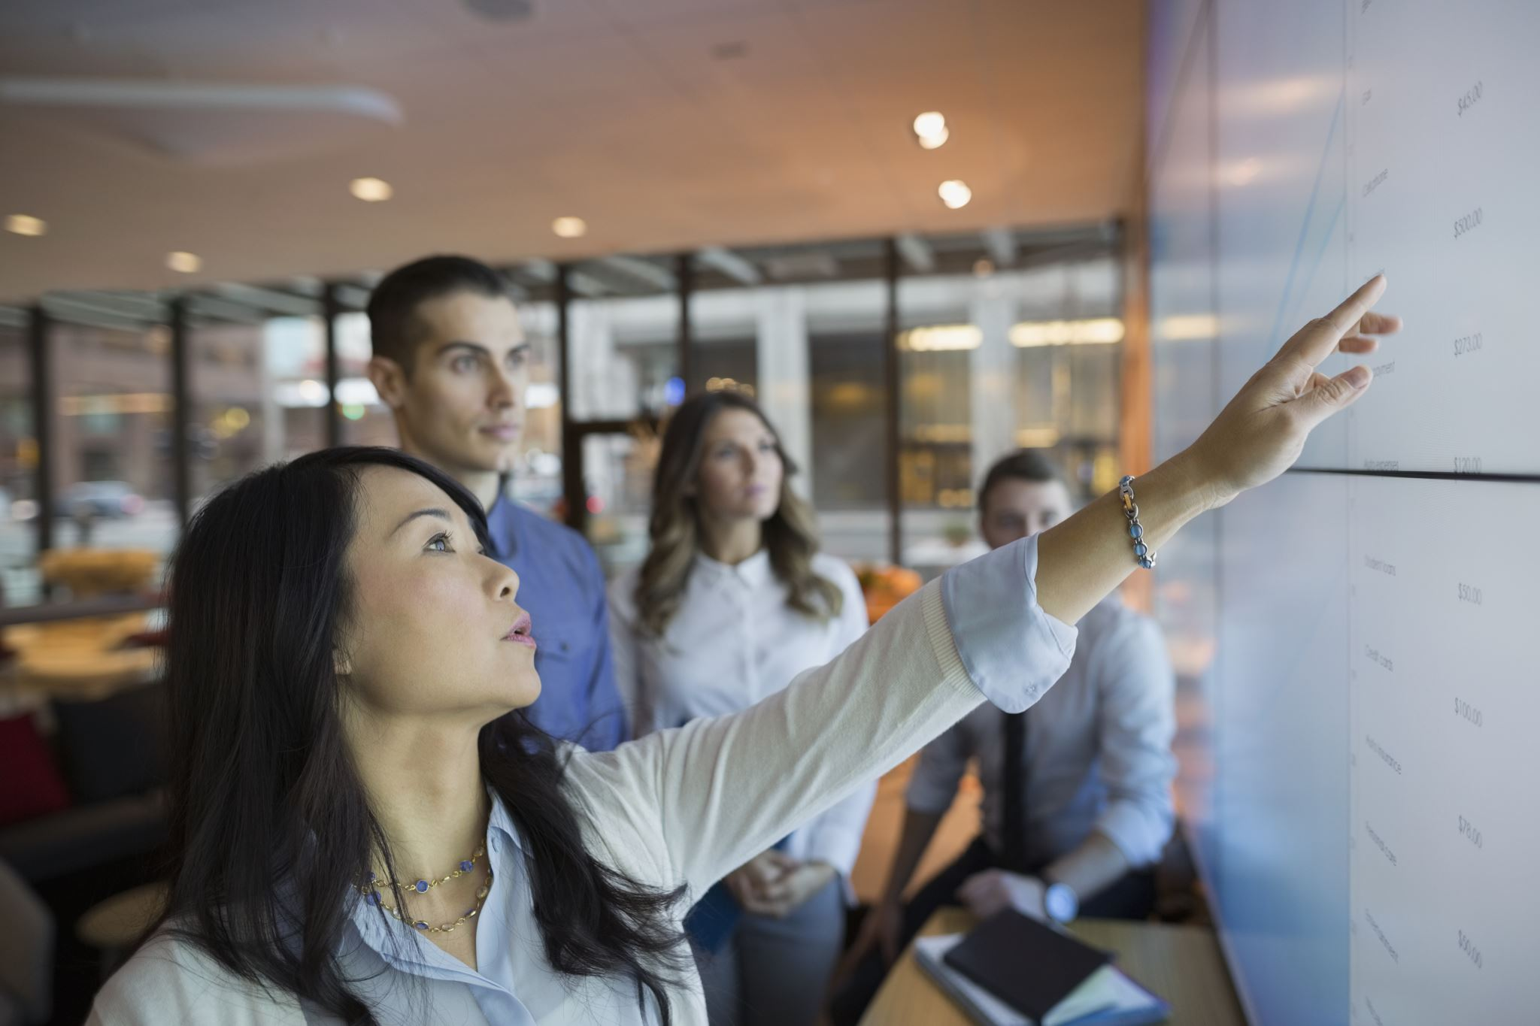

The Evolution of Facebook 2011-2021
The Society

Slide 2


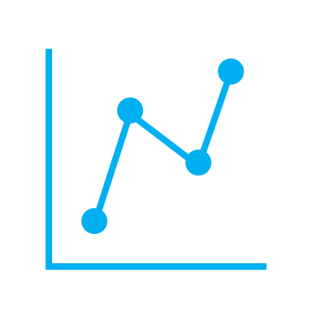

The Goal of Our Data
The keys to running a successful business is maintaining critical systems
Engagement
Trends
Time
[4]

Slide 3


Hypothesis:
The time you post affects your likes.
Question:
Takeaway#1
Takeaway#2
Takeaway#3
Does the time you post affect how many likes your post will get?

Slide 4
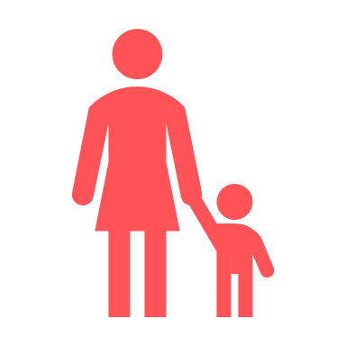
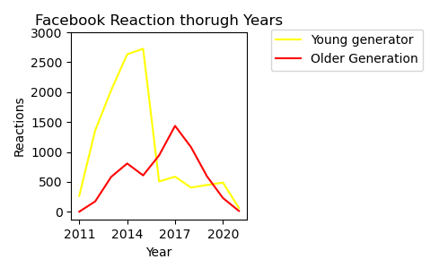
Hypothesis:
The older generation uses more reactions.
Question:
Takeaway#1
Takeaway#2
Takeaway#3
Which Generation reacted the most per hour?

Slide 5
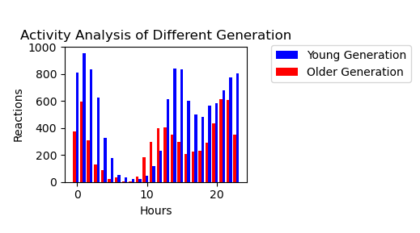
Continued:
The older generation uses more reactions.
Question:
Which Generation reacted the most per hour?

Slide 6


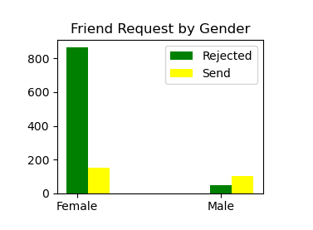
Hypothesis:
Males send more friend request.
Females reject more friend request
Question:
Takeaway#1
Takeaway#2
Takeaway#3
Which gender sends and rejects the most friend request?

